Slide 1
Predicting performance of online media content
Capstone Project II by Liudmila Khalitova
Supervisor Varun Bhatia
Springboard 2020

Slide 2
PROBLEM STATEMENT
AUDIENCEINTEREST
EDITORIAL DECISIONS
Drives editorial decisions regarding what gets published
Editors and reporters receive dozens of corporate press-releases each day. Only a tiny fraction of them receives coverage
PUBLIC RELATIONS CONTENT
Corporations compete for media and audience attention
Public relations practitioners have always been looking for ways to increase positive media attention to their organizations. One common practice includes media pitching and distribution of a company's news to journalists and media outlets via press releases. While public relations managers get to decide what kind of news their company will be sharing with media, journalists and editors are the gatekeepers deciding whether the audience of their outlets will actually see that news. Relevance and audience interest in a particular topic are one of the common factors that media professionals take into account when making editorial decisions. If a corporation's public relations department knows exactly what kind of their corporate news generate the most interest among media audiences, they would be able to pitch outlets more successfully by addressing the topics that attract readers the most.

Slide 3
Defining audience interest in online news content
You can edit this text. Edit this line of text. You can edit this text.
UNIQUE VISITORS
The number of people who have seen an online article
IMPRESSIONS
The number of times an article was viewed
LIFESPAN
The number of days an article continues to drive views and visits without a significant decline

Slide 4
RESEARCH QUESTIONS
What topics drive media attention toward organization?
Does audience interest in a news media article depend on the article’s topic?
Does an article’s lifespan depend on its topic?

Slide 5
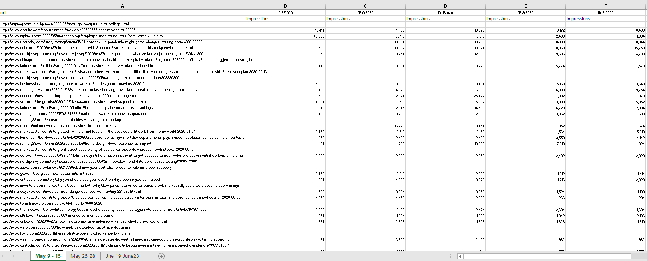
The dataset
The original data set represented an Excel file exported from the Cision Impact platform. The file had three sheets with date ranges: May 9-15, 2020, May 25-28, and June 19 through 23 of 2020. Each sheet had a column with URLs, columns with dates and sub-columns with metrics Impressions (how many times an article was viewed) and Unique Users (how many unique users have visited the page) on each day.

Slide 6
The approach
URL PARSING
Extracting article’s keywords from URLs.
KEY WORD EXTRACTION
Determining most important keywords with TF-IDF.
TOPIC MODELING
Grouping keywords into broader topics.
DATA CLEANSING
Preparing data for statistical analysis
STATSITICAL ANALYSES
ANCOVA and article half-life

Slide 7
TOPICS EXTRACTED
You can edit this text. Edit this line of text. You can edit this text.
BUSINESS AND TECHNOLOGY
EMPLOYEE WELLNESS
COVID-19 UPDATES
SPORTS AND COMPETITION
STOCK MARKET NEWS
REMOTE WORK
Notes:
Business and Technology
Sports and Competition
Remote Work
COVID-19 Updates
Employee Wellness
Stock Market Performance

Slide 8
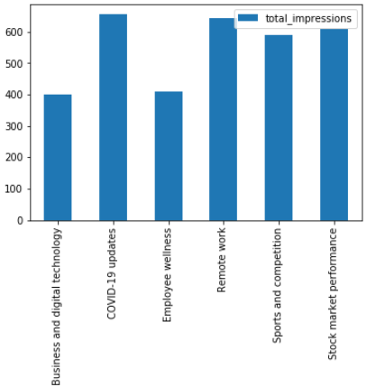
KEY FINDINGS
Business and Technology significantly differed from other topics in terms of their ability to generate impressions. This topic, on average, received 209 views fewer than other topics (p = .028). Pairwise comparisons revealed that in comparison with Remote Work, Business and Technology received 244 fewer views (p = .043); in comparison with COVID-19 Updates it had 255 fewer views (p = .015) and 209 fewer views than Stock Market Performance (p = .028). There were no statistically significant differences between Business and Technology and Sports and Competition and Business and Technology and Employee Wellness.

Slide 9
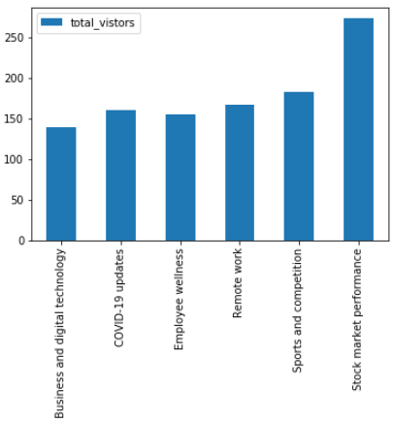
KEY FINDINGS
Stock Market Performance performed significantly better than every other topic in terms of unique visitors. On average, it attracted 92 users more than Sports and Competition (p = .042), 133 users more than Business and Technology (p = .004), 106 users more than Remote Work (p = .033), 113 users more than COVID-19 (p = .018), and 118 users more than Employee Wellness (p = .022).

Slide 10
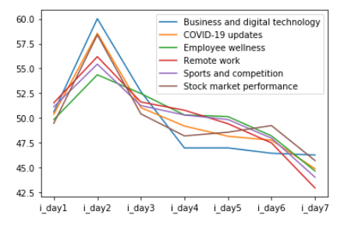
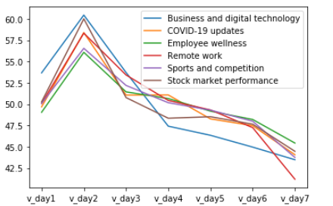
KEY FINDINGS
Both unique visitors and impressions across all topics peak around day 2, remain relatively stable on days 3 to 6, and drop from day 6. The decline for Business and Digital Technology seems to be the most dramatic.
Notes:
Highloight keywords

Slide 11
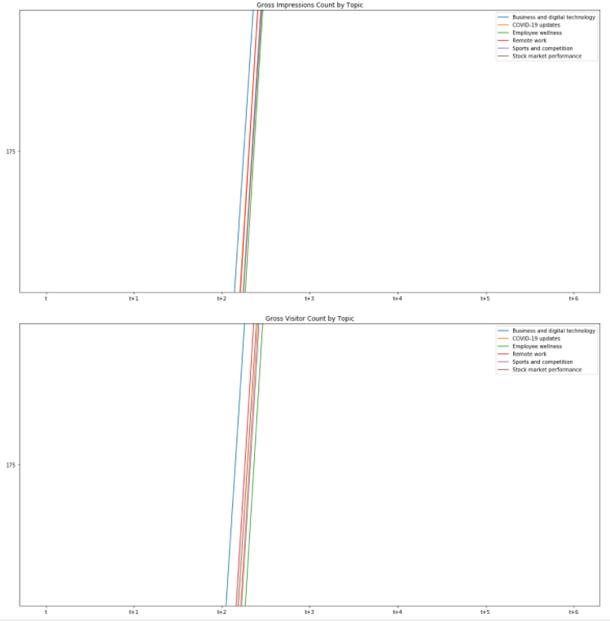
KEY FINDINGS
The charts suggest that regardless of topic, all articles reach their half-life between days 3 (t+2) and 4 (t+3) since their publication (t). while Business and Technology does reach its half-life slightly quicker than other topics, still it remains within the same range as other topics (day 3 to 4). This means that an article's topic did not significantly affect its lifespan, meaning that readers were loosing interest in online content at approximately the same rate across topics

Slide 12
limitations
The dataset used in this study was limited to news media articles mentioning only one company, Service Now. Therefore, the generalizability of the findings presented across companies and industries is unknown. More research needed to confirm our findings regarding of the lifespan of online news content. In addition, I investigated the topics relevant specifically to Service Now, it is not clear how applicable they would be even within the same industry. Finally, some of the extracted topics are specific to the time frame when the data was collected (e.g. May – June 2020), when COVID-19 coverage was especially prominent. Therefore, the topic extraction procedure may need to be repeated for each client if the media landscape significantly changes.

